Slide 1
Dotnet PRogramming
Mohamad Danial Wafiy bin Mohd Fairuz (AI160064)
Pravart A/L Nai Prased (AI150200)
Koit Yong Jiat (AI160192)
Nyzveldo Augustin (AI160066)
Suthanon A/L Sombun (AI160060)

Slide 2
UTHM MEETING MANAGEMENT SYSTEM
Project Description
Handle and manage meeting between students and lecturers.
Provide a platform for students to view lecturer’s time table easily through this system.
Has a centralized lecturer’s time table.
Provide a platform for students to make meeting booking with the lecturer using this system.
Notify lecturers and students whenever there is a cancelation of meeting that has been made.

Slide 3
features
Features | Suggested by
Register | Pravart (API:Facebook & etc)
Login | Nyzveldo Augustin (API: Facebook & etc)
Lecturer’s time table management | Koit (API: Spreadsheet)
View lecturer’s time table | Koit (Database)
Book a meeting | Nyzveldo Augustin (Database)
Accept or decline meeting | Suthanon (Database)
Messages section | Wafiy (Database)
View booked meeting | Pravart (Database)
Student notifier | Wafiy (API)
Chat | Suthanon (API: WhatsApp)

Slide 4
Features
Register
Allow lecturers and students to register for the first time.
Login
Allow lecturers and students to login into the system.
Lecturer’s time table management
Allow lecturers to insert, update or delete the time table to show free time.
Lecturer get to download the timetable as a Spreadsheet file.
View lecturer’s time table
Students can view lecturer’s time table as to check on their free time.
Book a meeting
Students can book a meeting with the lecturer by setting a date and time of meeting.

Slide 5
features
Accept or decline booking
Lecturer can accept or decline the meeting with students depending on their preferences.
Messages section
Students or lecturers can check the status for the meeting either it cancelled or not.
View booked meeting
Students can view their booked meeting as to check on the day and time if there are several meetings.
Student notifier
Lecturers get to leave a memo to the specific student which will then notify the student.
Chat
This features allow students or lecturer to click a chat button in a user’s profile that they want to contact and it will be redirect to WhatsApp web chat. This allows them to ask for communicate with each others.

Slide 6
architecture

Slide 8
interface

Slide 9
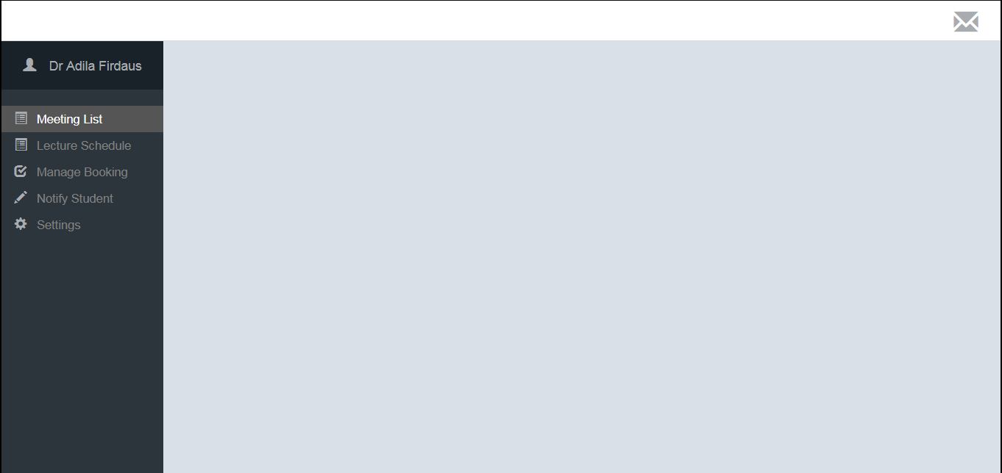
Lecture’s master page

Slide 10
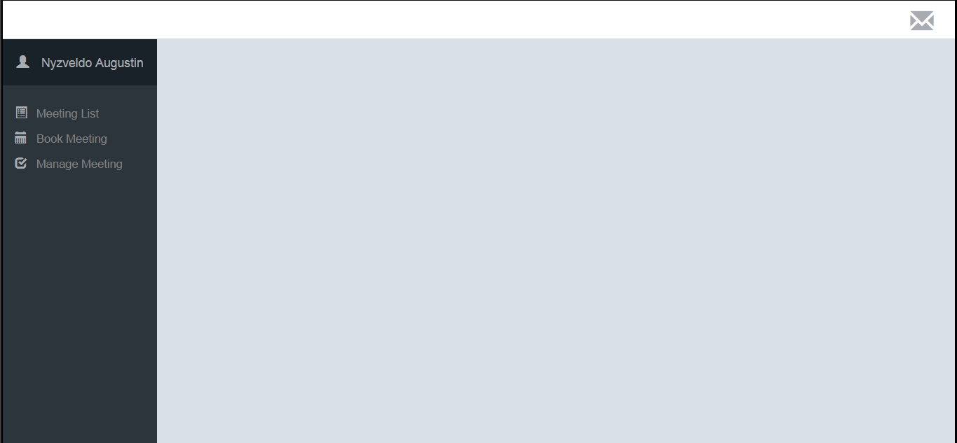
Student’s master page

